Slide 1
Docker & Kubernetes(K8)

Slide 2
Docker & Kubernetes(K8) Differences
Kubernetes and Docker are both fundamentally different technologies but they work very well together, and both facilitate the management and deployment of containers in a distributed architecture.

Slide 3
What are Containers?
Light-Weight, Standalone, executable package
Platform agnostic
Isolate software from Surroundings

Slide 4
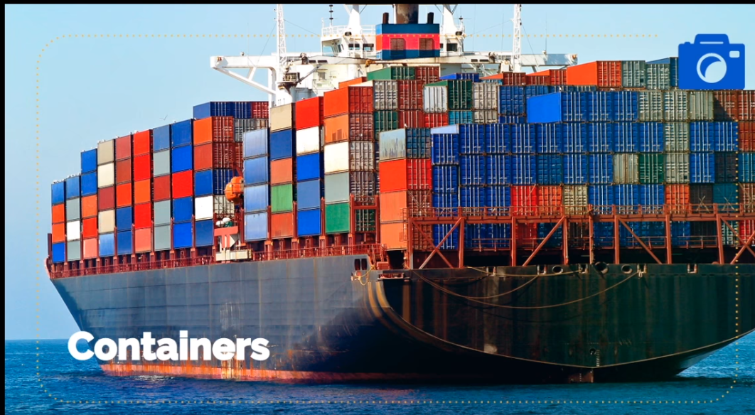
What are Containers?

Slide 5
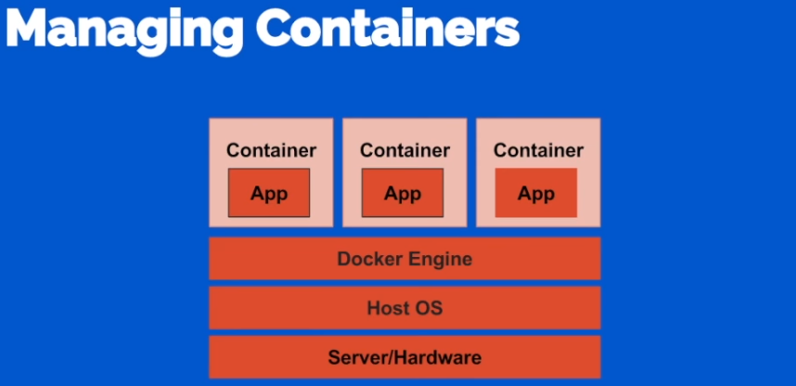
Why Container Orchestration?
When we have Containers, and they have lot of advantages, then what is the need of Orchestration?
Multiple containers on a Single Server/node

Slide 6
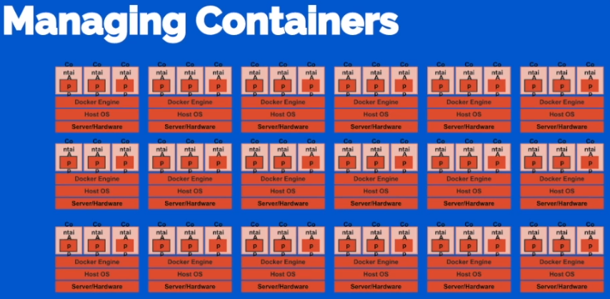
Why Container Orchestration?
It looks something like below…

Slide 7
Why Container Orchestration?
Then what are the problems, we need to come across
How to track which Service runs on which node?
Grouping nodes based on Service?
Tedious to deploy Images to each of node.
How to distribute load to various Nodes/Containers.
Taking care of which Node/Container is down
How to abstract away the internal architecture of Nodes/Containers to external world
And many more…

Slide 8
Container Orchestration
All these problems are taken care by Container Orchestration Platform or Tool, Kubernetes which is also referred as K8s
Opensource created by Google, Google Cloud uses Kubernetes.
Separates the Nodes logically into Clusters
Pods are nodes or serves. A pod can have multiple Containers deployed & running.

Slide 9
Container Orchestration
Groups Nodes into Clusters
Horizontal Scaling, no. of containers/pod can be scaled.
Self Healing, restarts Pods whenever required, Health checks, whenever nodes doesn’t respond, no request are being sent to it temporarily, until its active and up.
K8s give ip addresses to Nodes, load balancing, Service Discovery
Roll Out/Roll In, when you are rolling to if multiple instances, then K8s automatically brings down few nodes and rolls new release, if any problem roll back is done automatically.
Provides loose coupling between pods.

Slide 10
Container Orchestration
Ofcourse all these are achieved without any Source code change in the Business Application.

Slide 11
What is a pod?
A pod is a collection of containers and its storage inside a node of a Kubernetes cluster. It is possible to create a pod with multiple containers inside it. For example, keeping a database container and data container in the same pod.
Types of Pod
There are two types of Pods −
Single container pod
Multi container pod
Single Container Pod
They can be simply created with the kubctl run command, where you have a defined image on the Docker registry which we will pull while creating a pod.
$ kubectl run <name of pod> --image=<name of the image from registry> Example − We will create a pod with a tomcat image which is available on the Docker hub.
$ kubectl run tomcat --image = tomcat:8.0

Slide 12
Kubernetes App Deployment
Deployment is a method of converting images to containers and then allocating those images to pods in the Kubernetes cluster.
This also helps in setting up the application cluster which includes deployment of service, pod, replication controller and replica set.
The cluster can be set up in such a way that the applications deployed on the pod can communicate with each other.
In this setup, we can have a load balancer setting on top of one application diverting traffic to a set of pods and later they communicate to backend pods.
The communication between pods happen via the service object built in Kubernetes.

Slide 13
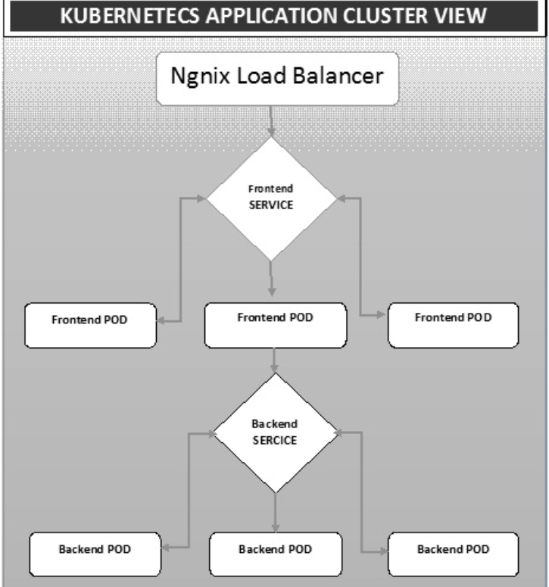
Kubernetes App Deployment

Slide 14
What is AutoScaling?
Kubernetes - Autoscaling. Autoscaling is one of the key features in Kubernetes cluster. It is a feature in which the cluster is capable of increasing the number of nodes as the demand for service response increases and decrease the number of nodes as the requirement decreases.

Slide 15
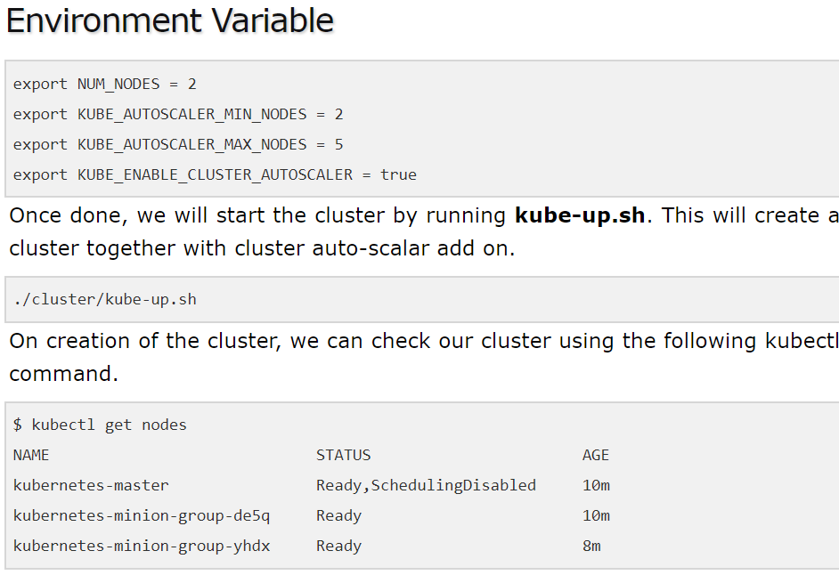
Kubernetes AutoScaling

Slide 16
Kubernetes AutoScaling

Slide 17
Kubernetes AutoScaling
Now, we can deploy an application on the cluster and then enable the horizontal pod autoscaler. This can be done using the following command.
$ kubectl autoscale deployment <Application Name> --cpu-percent = 50 --min = 1 -- max = 10
The above command shows that we will maintain at least one and maximum 10 replica of the POD as the load on the application increases.
We can check the status of autoscaler by running the $kubclt get hpacommand.

Slide 18
Kubernetes AutoScaling
We can check the number of pods running using the following command.
jsz@jsz-desk2:~/k8s-src$ kubectl get pods
php-apache-2046965998-3ewo6 0/1 Pending 0 1m
php-apache-2046965998-8m03k 1/1 Running 0 1m
php-apache-2046965998-ddpgp 1/1 Running 0 5m
php-apache-2046965998-lrik6 1/1 Running 0 1m
php-apache-2046965998-nj465 0/1 Pending 0 1m

Slide 19
Kubectl Commands
Kubectl controls the Kubernetes Cluster. It is one of the key components of Kubernetes which runs on the workstation on any machine when the setup is done. It has the capability to manage the nodes in the cluster.
Kubectl commands are used to interact and manage Kubernetes objects and the cluster. In this chapter, we will discuss a few commands used in Kubernetes via kubectl.
kubectl annotate − It updates the annotation on a resource.
$kubectl annotate [--overwrite] (-f FILENAME | TYPE NAME) KEY_1=VAL_1 ... KEY_N = VAL_N [--resource-version = version]
For example,
kubectl annotate pods tomcat description = 'my frontend'
kubectl api-versions − It prints the supported versions of API on the cluster.
$ kubectl api-version;
kubectl apply − It has the capability to configure a resource by file or stdin.
$ kubectl apply –f <filename>

Slide 20
Kubectl Commands
kubectl attach − This attaches things to the running container.
$ kubectl attach <pod> –c <container> $ kubectl attach 123456-7890 -c tomcat-conatiner
kubectl autoscale − This is used to auto scale pods which are defined such as Deployment, replica set, Replication Controller.
$ kubectl autoscale (-f FILENAME | TYPE NAME | TYPE/NAME) [--min = MINPODS] -- max = MAXPODS [--cpu-percent = CPU] [flags] $ kubectl autoscale deployment foo --min = 2 --max = 10
kubectl cluster-info − It displays the cluster Info.
$ kubectl cluster-info
kubectl cluster-info dump − It dumps relevant information regarding cluster for debugging and diagnosis.
$ kubectl cluster-info dump $ kubectl cluster-info dump --output-directory = /path/to/cluster-state

Slide 21
Kubectl Commands
kubectl config delete-cluster − Deletes the specified cluster from kubeconfig.
$ kubectl config delete-cluster <Cluster Name>
kubectl config delete-context − Deletes a specified context from kubeconfig.
$ kubectl config delete-context <Context Name>
kubectl config get-clusters − Displays cluster defined in the kubeconfig.
$ kubectl config get-cluster $ kubectl config get-cluster <Cluser Name>
kubectl config get-contexts − Describes one or many contexts.
$ kubectl config get-context <Context Name>
kubectl exec − This helps to execute a command in the container.
$ kubectl exec POD <-c CONTAINER > -- COMMAND < args...> $ kubectl exec tomcat 123-5-456 date

Slide 22
Kubectl Commands
kubectl rolling-update − Performs a rolling update on a replication controller. Replaces the specified replication controller with a new replication controller by updating a POD at a time.
$ kubectl rolling-update OLD_CONTROLLER_NAME ([NEW_CONTROLLER_NAME] -- image = NEW_CONTAINER_IMAGE | -f NEW_CONTROLLER_SPEC) $ kubectl rolling-update frontend-v1 –f freontend-v2.yaml
kubectl rollout − It is capable of managing the rollout of deployment.
$ Kubectl rollout <Sub Command> $ kubectl rollout undo deployment/tomcat
Apart from the above, we can perform multiple tasks using the rollout such as −
rollout history
rollout pause
rollout resume
rollout status
rollout undo
kubectl run − Run command has the capability to run an image on the Kubernetes cluster.
$ kubectl run NAME --image = image [--env = "key = value"] [--port = port] [-- replicas = replicas] [--dry-run = bool] [--overrides = inline-json] [--command] -- [COMMAND] [args...] $ kubectl run tomcat --image = tomcat:7.0 $ kubectl run tomcat –-image = tomcat:7.0 –port = 5000
kubectl scale − It will scale the size of Kubernetes Deployments, ReplicaSet, Replication Controller, or job.
$ kubectl scale [--resource-version = version] [--current-replicas = count] -- replicas = COUNT (-f FILENAME | TYPE NAME ) $ kubectl scale –-replica = 3 rs/tomcat $ kubectl scale –replica = 3 tomcat.yaml

Slide 23
Kubectl Commands
kubectl top node − It displays CPU/Memory/Storage usage. The top command allows you to see the resource consumption for nodes.
$ kubectl top node [node Name] The same command can be used with a pod as well.

